Slide 1
EMPLOYE LEAVE MANAGEMENT SYSTEM

Slide 2
01.
05.
Introduction
Entity Modules
02.
06.
Key Points
Database Structure
03.
07.
System Requirements
Project Output
04.
08.
UML Diagrams
Project Output
table of contents

Slide 3
01.
Introduction

Slide 4

Employee Leave Management System
System where Employee can easily Apply for leave

Slide 5
• The main objective of the proposed system is to decrease the paper work and easier record maintenance by having a particular website for leaves maintenance.
• This approach basically deals with the record of leaves taken by Employees in the organization.
This system also approach to reduce the formality and time delay facing by Employee and Admin Members for approval of Leaves

Slide 6
• With the introduction of Leave Management System, the software to track the leaves and absenteeism of employees, the work of human resource managers as well as that of managers of respective departments has reduced considerably.
• Leave Management System software helps the human resource to introduce leaves policies that work in favor of the employees. With flexibility and reliability, managers can track the leave patterns too with the help of analysis report. The software has allowed the human resource department to evolve their policies and align the needs of the employees systematically.

Slide 7
02.
Key Points

Slide 8


Leave
management System
Productivity
Perks
Increases productivity of the organization by streamlining the leaves of the employees.
Employees enjoy the privileges of leave without disturbing the work process of the department.
Hassles System
Easy Management
The software helps ensure the compliance to labor laws without any hassles.
Manages the system of leaves and makes it easy to refer later by managers.

Slide 9
Existing System
In the current system, Employee have to suffer lots of problems and formalities for the approval of leave.
Lengthy Process
In todays system Employee specially HR have to maintain a leave register and slip for the record of leave, all the activities in this system are done manually and which results Employee to face cumbersome.
TDS Task

Slide 10
Proposed System
The proposed system automates the existing system. It decreases the paper work and easier record maintenance by having a Database for leaves maintenance.
Decrease Paperwork
The Leave Management System reduces the over work and time duration. It provide a easy maintained and systematic environment for the higher panel (HOD/Admin) for the approval of leave.
Reduce work/Time Duration
This is a systematic approach that follow a sequence for the leave approval, this will result low overhead of work.
systematic approach

Slide 11
03.
System Requirements

Slide 12

methodology
SOFTWARE REQUIREMENTS SPECIFICATION
HARDWARE REQUIREMENTS SPECIFICATION:
Processor: Intel I3 and above
RAM :above 4 GB and above
Hard Disk:2 GB and above
Output :Postman
Back End: MySql
PLATFORM USED: Eclise

Slide 13
04.
UML Diagrams

Slide 14
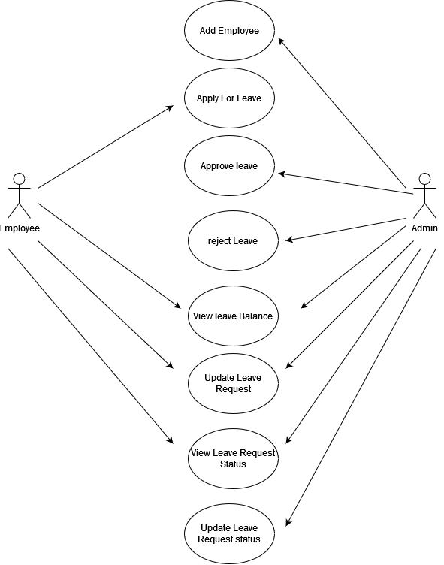
Use Case Diagram

Slide 15
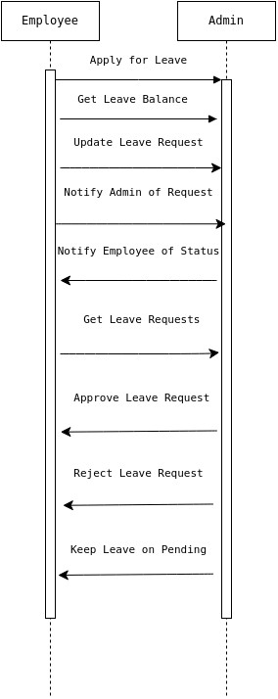
Sequence Diagram

Slide 16
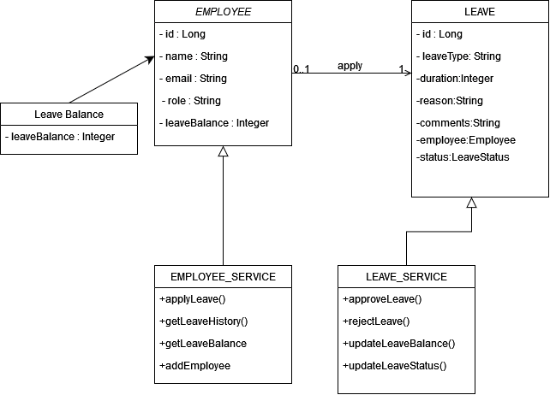
Class Diagram

Slide 17
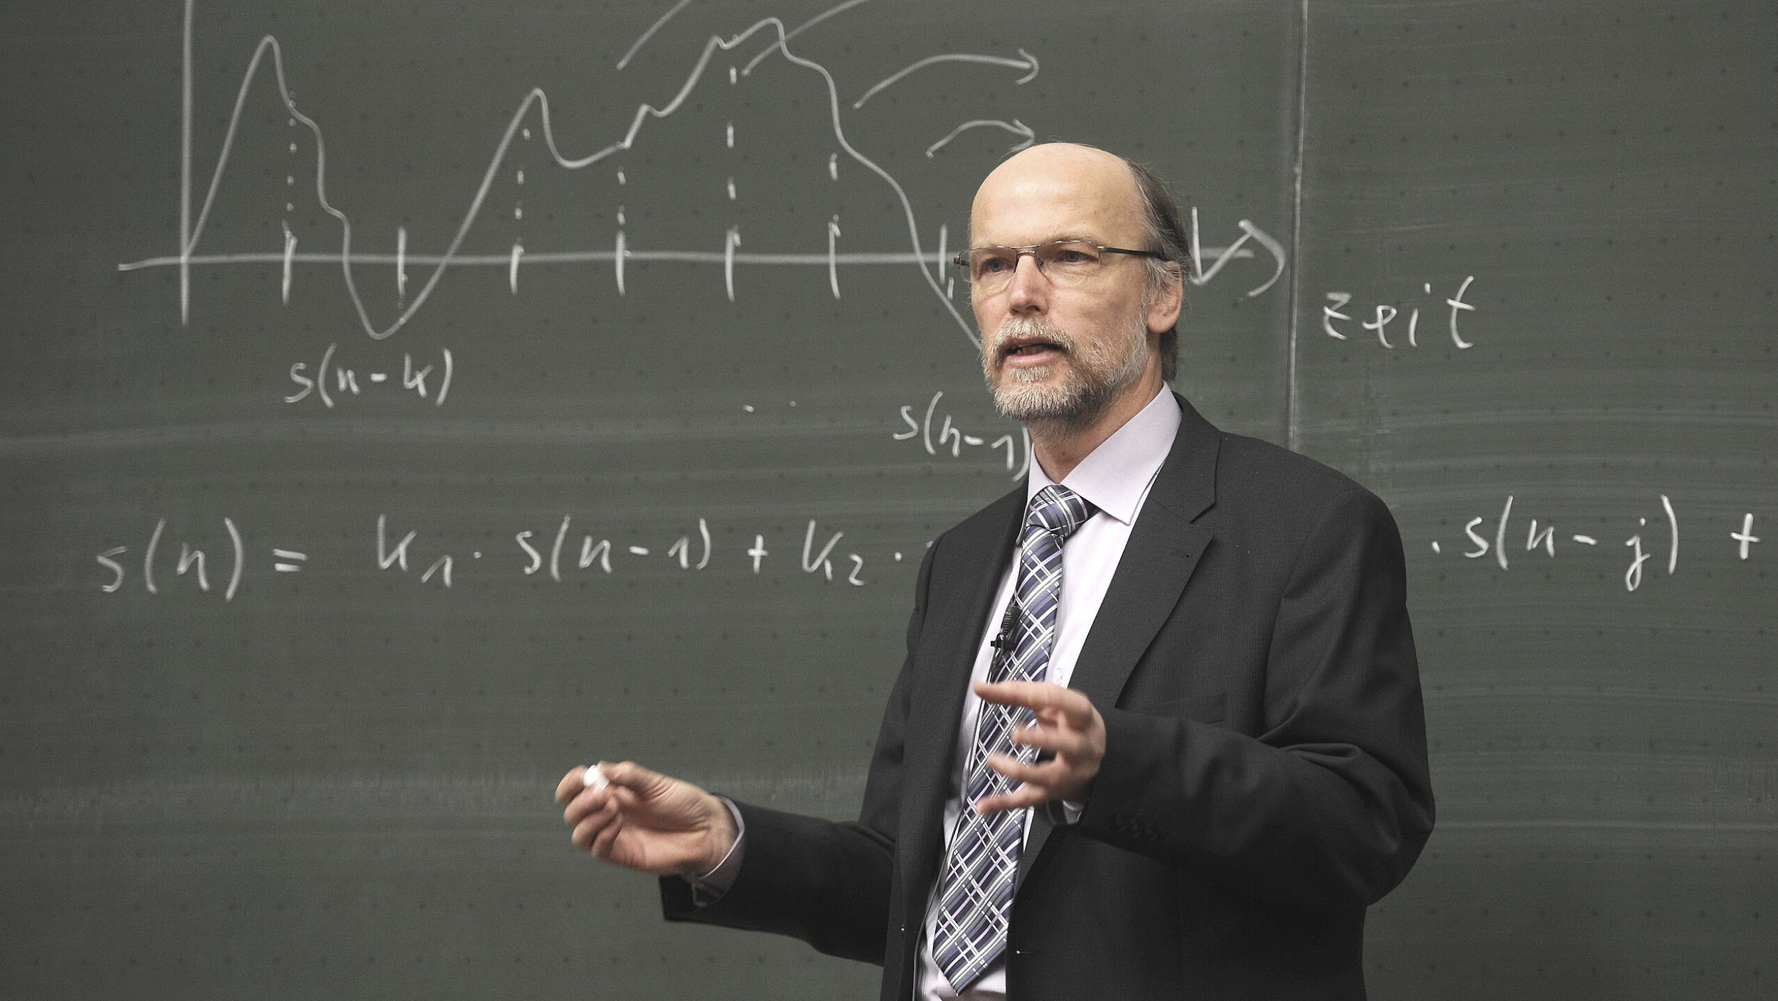
Entity Modules

Slide 18

Employee Module
► Employee can apply for the leave application with the unique id which is provided by the admin module.
► Based on the availability of leave, employee can apply for leave online.
Casual leave, Privilege leave, Sick leave, Compensatory off
►Employee is able to see his/her leave record in a particular month or year and its type also.

Slide 19
Admin Module
► This module is having the power of leave verification of the employees.
Admin is able to see the leave record of employees.
➤ HOD's can verify the leave on the basis of the leave availability of the student and in case of student attendance is the basic criteria.
➤ After the leave verification leave is transferred to the Warden for the approval.
HOD is having authority of approval or disapproval of leave and remark on that.

Slide 20
05.
Project Output

Slide 21
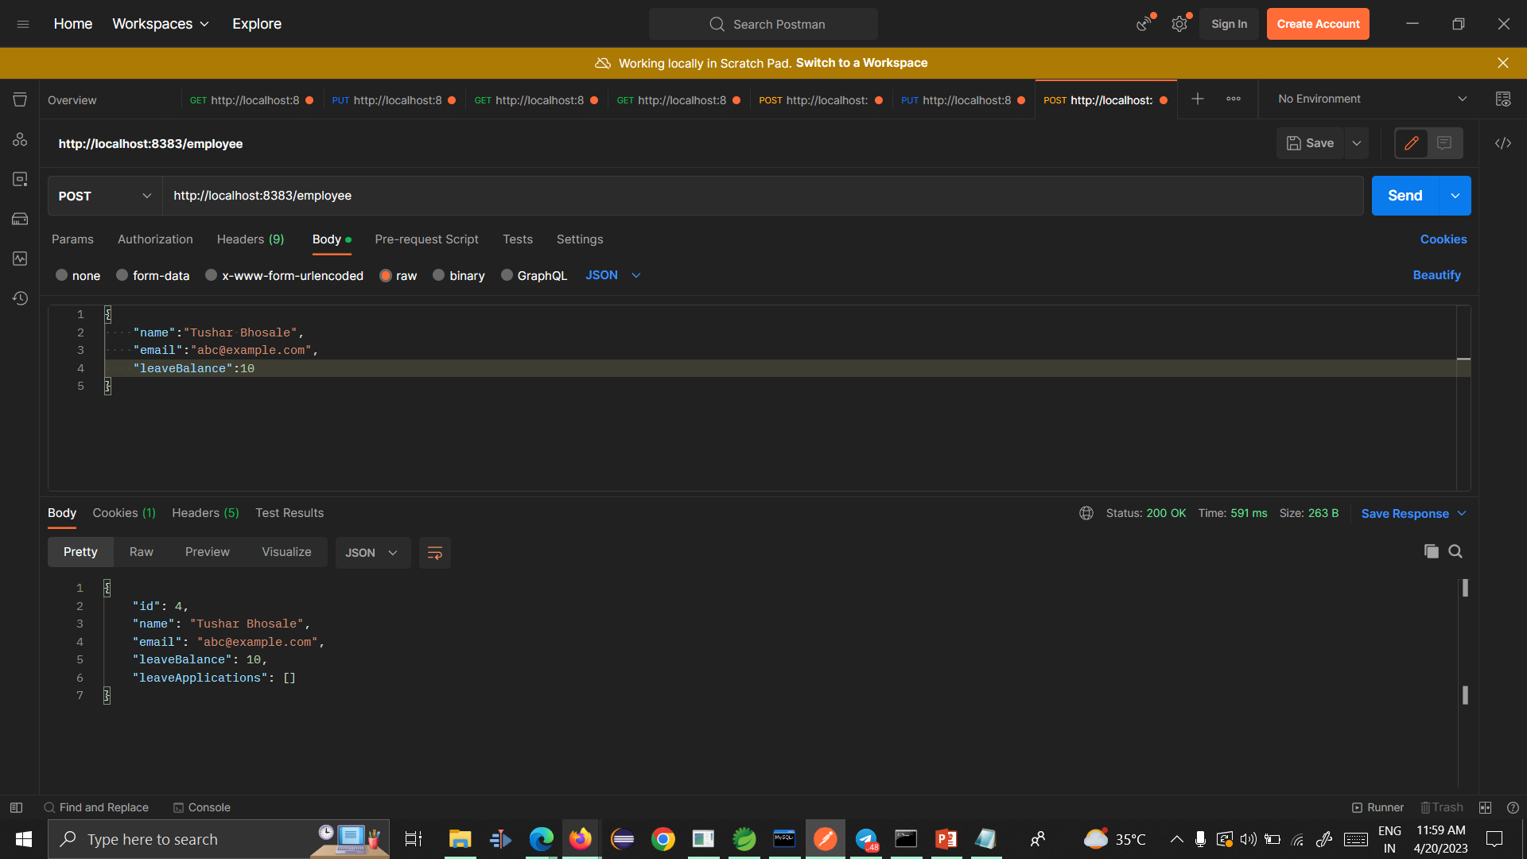


In 1st pic I am adding the Employee

Slide 22
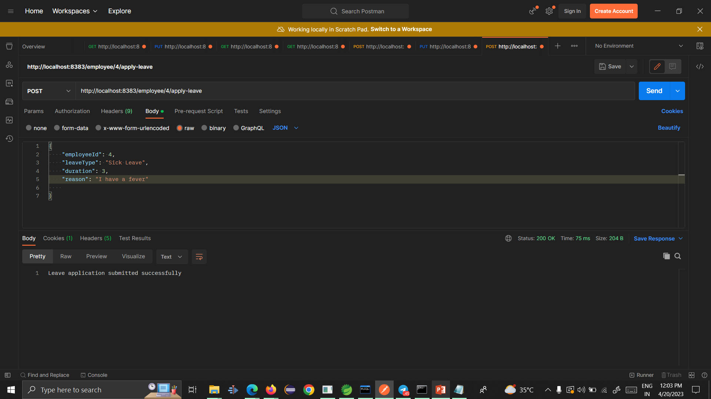
And in 2nd Pic I am As employee Apply for leave.

Slide 23
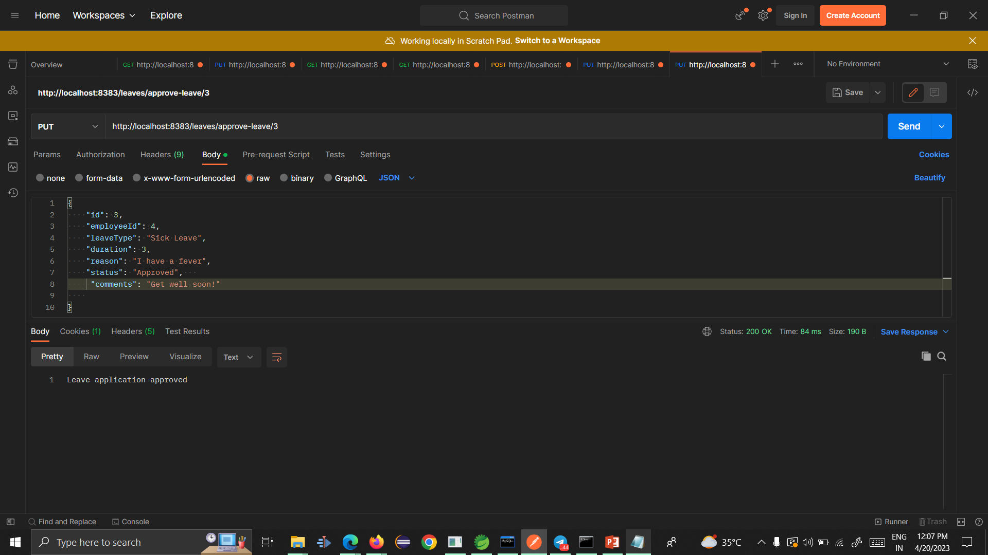
I this as Admin I can approve for leave

Slide 24
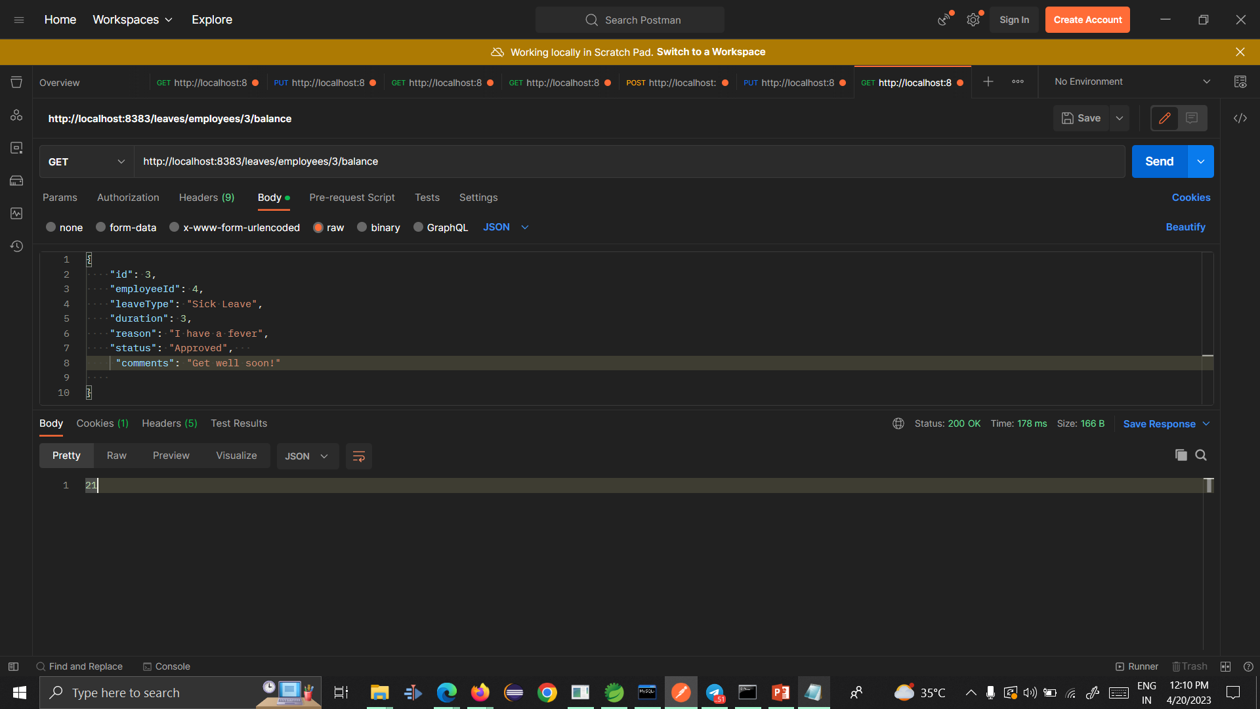
I this I can see the balance of particular employee

Slide 25

add a main point
Elaborate on what you want to discuss.
add a main point
Elaborate on what you want to discuss.
add a main point
study objectives
Elaborate on what you want to discuss.

Slide 26

thank you!
Write a closing statement or call-to-action here.

Slide 27

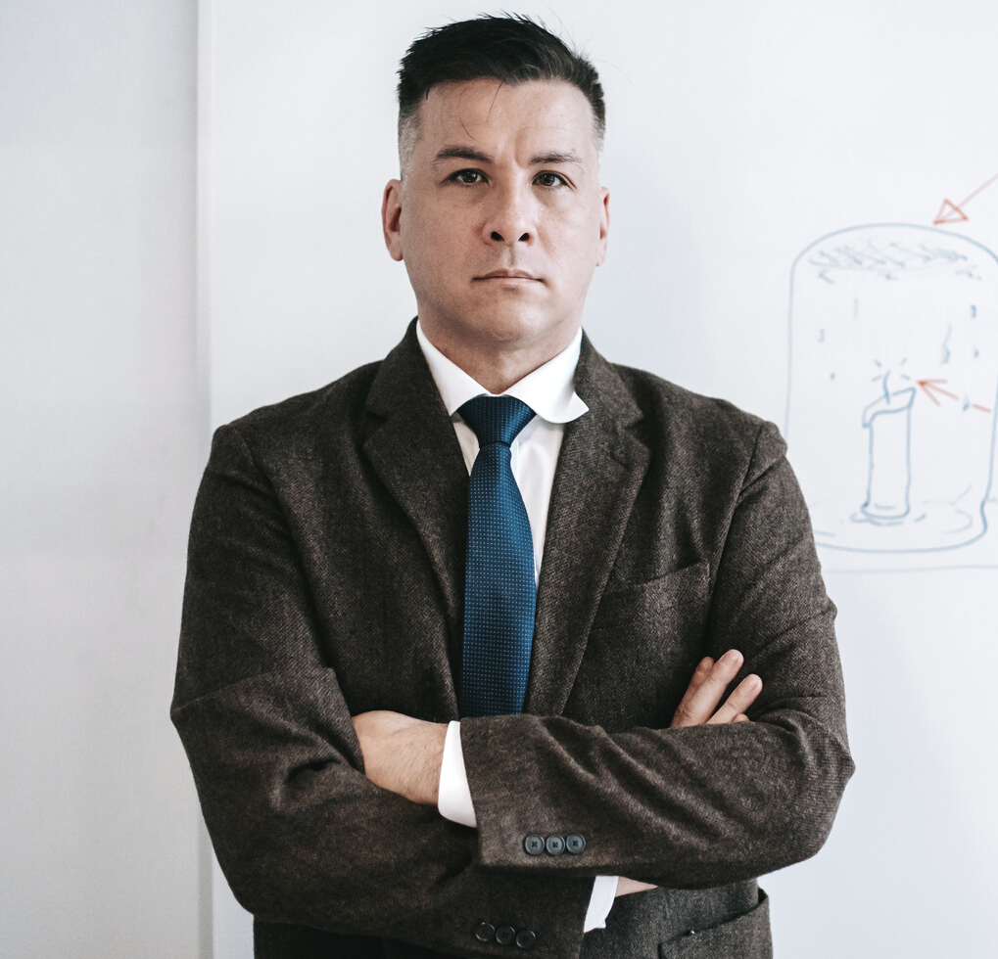


add a team
members page
Elaborate on what you want to discuss.
Name
Name
Name
Name
Title or Position
Title or Position
Title or Position
Title or Position

Slide 28

get in touch
Email
hello@reallygreatsite.com
Social Media
@reallygreatsite
Call us
123-456-7890

Slide 29

This presentation template is free for everyone to use thanks to the following:
SlidesCarnival for the presentation template
Pexels for the photos
happy designing!
credits

Slide 30


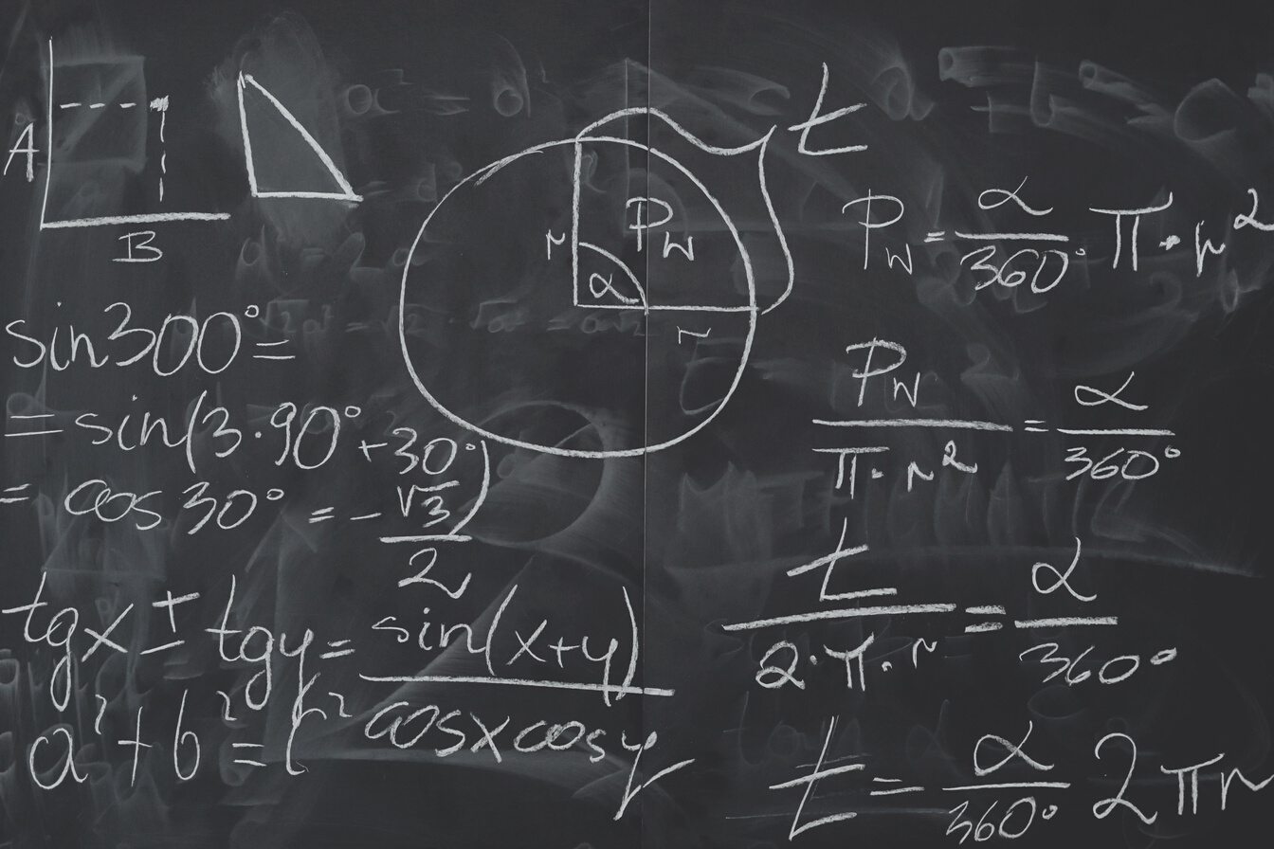
This presentation template uses the following free fonts:
Titles: Playfair Display Black
Headers: Roboto
Body Copy: Roboto
You can find these fonts online too.
Happy designing!
fonts in this presentation

Slide 31
add a timeline page
Add a main point
Add a main point
Add a main point
Elaborate on what you want to discuss.
Elaborate on what you want to discuss.
Elaborate on what you want to discuss.
Add a main point
Add a main point
Add a main point
Elaborate on what you want to discuss.
Elaborate on what you want to discuss.
Elaborate on what you want to discuss.

Slide 32
swot analysis
S
O
What are you doing well?
What sets you apart?
What are your good qualities?
What are your goals?
Are demands shifting?
How can it be improved?
Where do you need
to improve?
Are resources adequate?
What do others do better than you?
W
T
What are the blockers
you're facing?
What are factors outside of
your control?

Slide 33

analysis of the results
25
20
Elaborate on what you want to discuss.
15
10
5
0
Item 1
Item 2
Item 3
Item 4
Item 5

Slide 34
Name
add a chart page
Job Title
Name
Name
Job Title
Job Title
Name
Name
Name
Name
Job Title
Job Title
Job Title
Job Title

Slide 35







































resource
page
Use these design resources in your Canva Presentation. Happy designing!
Don't forget to delete this page before presenting.

Slide 36

free templates for all your presentation needs
For PowerPoint, Google Slides, and Canva
100% free for
personal or commercial use
Ready to use, professional, and customizable
Blow your audience away with attractive visuals

Slide 37

about me
I'm Rain.
Welcome to my education presentation.
Follow me at @reallygreatsite to learn more.

Slide 38
pretitle
title
Paragraph 1 Present with ease and wow any audience with Canva Presentations. Choose from over a thousand professionally-made templates to fit any objective or topic. Make it your own by customizing it with text and photos.
subtitle
heading 1
heading 2
Paragraph 2 Present with ease and wow any audience with Canva Presentations. Choose from over a thousand professionally-made templates to fit any objective or topic. Make it your own by customizing it with text and photos.
heading 3
heading 4
heading 5
heading 6
footer

Slide 39
how to use this presentation
Google Slides
PowerPoint
Canva
Click on the "Google Slides" button below this presentation preview.
Click on "Make a copy."
Start editing your presentation.
You need to sign in to your Google account.
Click on the "PowerPoint" button below this presentation preview.
Start editing your presentation.
Download and install the fonts used in this presentation as listed on the next page.
Click on the "Canva" button under this presentation preview.
Start editing your presentation.
You need to sign in to your Canva account.

Slide 40
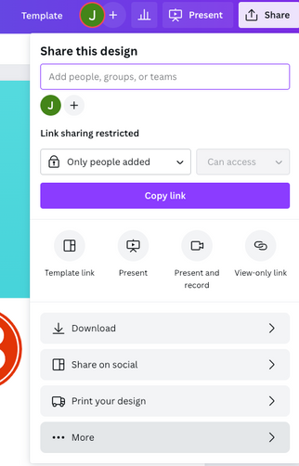
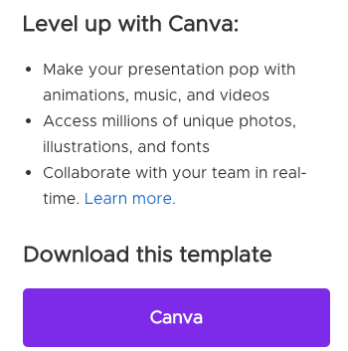
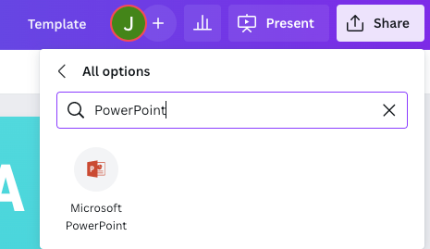
download this presentation as
a Powerpoint template in 3 steps
1
2
3
Click on the "Canva" button next to this presentation. Start editing your presentation. You may need to sign in to your Canva account.
Click on the "Share" button on the top right corner in Canva and click on "More" at the bottom of the menu.
Enter "PowerPoint" in the search bar and click on the PowerPoint icon to download.

Slide 41
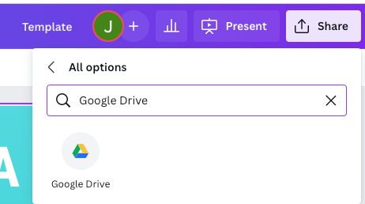
download this presentation as
a Google Slides template in 3 steps
1
2
3
Click on the "Canva" button next to this presentation. Start editing your presentation. You may need to sign in to your Canva account.
Click on the "Share" button on the top right corner in Canva and click on "More" at the bottom of the menu.
Enter "Google Drive" in the search bar and click on the Google Drive icon to add this design as a Google slide in your G Drive. It will ask you to link your Google account to Canva the first time.

